Slide 1


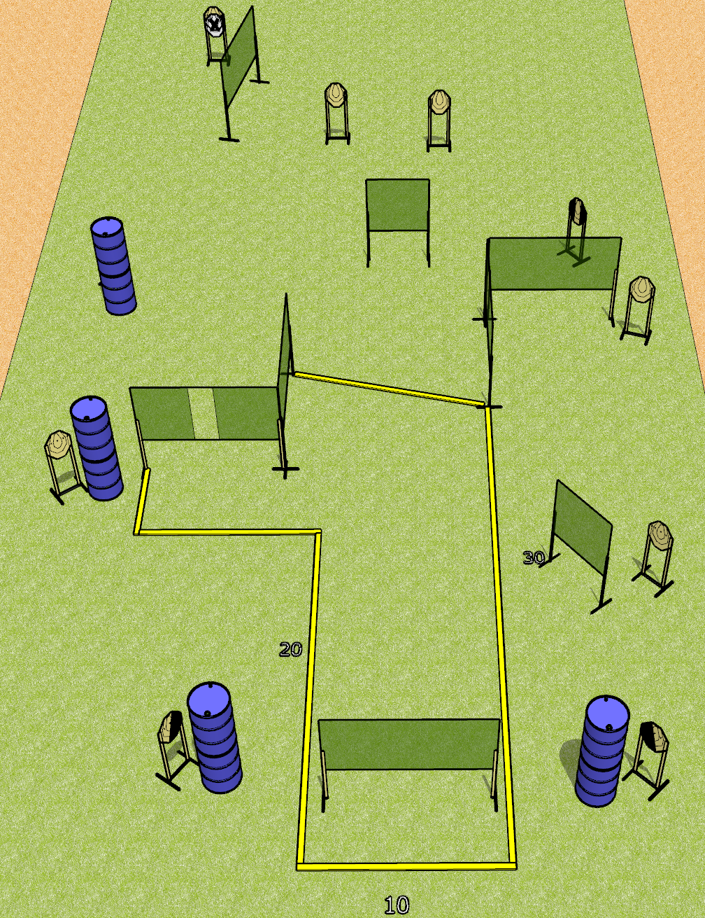
 | Dothan Gun Club – USPSA Match We Have Ways Course Designer : Drew Coleman
Round Count 20 rounds 10 IPSC
Equipment List 14 wall feet 1 left + 1 right dia, 1 tux 8 targets (7 + 1 NS)

Slide 2
We Have Ways
Written Stage Briefing
We Have Ways is a 20 round, 100-point, Comstock course of fire. There are 10 IPSC targets. The best 2 hits will score.
Handgun start position is anywhere completely outside the shooting area, wrists below belt.. Handgun is loaded and holstered.
PCC start position is anywhere completely outside the shooting area, stock on belt. Loaded carbine is held with both hands, safety on.
On the audible start signal, engage targets as they become available from within the shooting area.

Slide 3
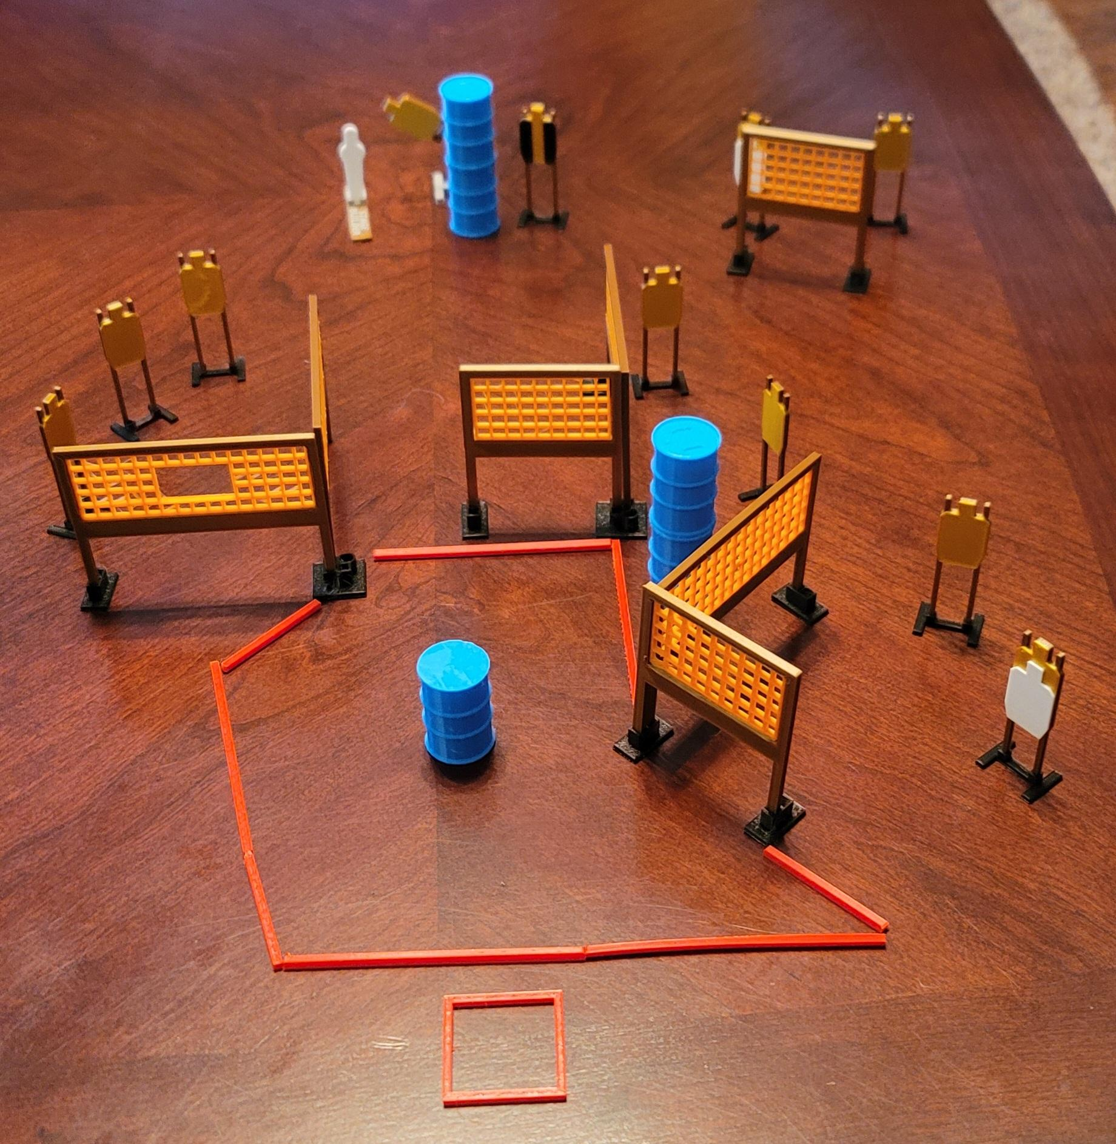
 | Dothan Gun Club – USPSA Match Pick it up and go! Course Designer : Eric Henwood
Round Count 23 rounds 11 USPSA 1 pepper popper
Equipment List 11 wall feet 2 medium fault lines Swinger + activator 1 tux 12 targets (10 + 2 NS)

Slide 4
Pick it up and go!
Written Stage Briefing
Pick it up and Go! Is a 23 round, 115-point, Comstock course of fire. There are 11 USPSA targets and 1 steel. The best 2 hits on cardboard will score and steel must fall to score.
The swinger is activated by the popper and remains visible at rest.
Handgun start position is feet on marks, wrists below belt. Handgun is UNLOADED and holstered.
PCC start position is feet on marks, stock on belt. UNLOADED carbine is held with both hands.
All magazines to be used must start on barrel/table in shooting area.
On the audible start signal, engage targets as they become available from within the shooting area.

Slide 5
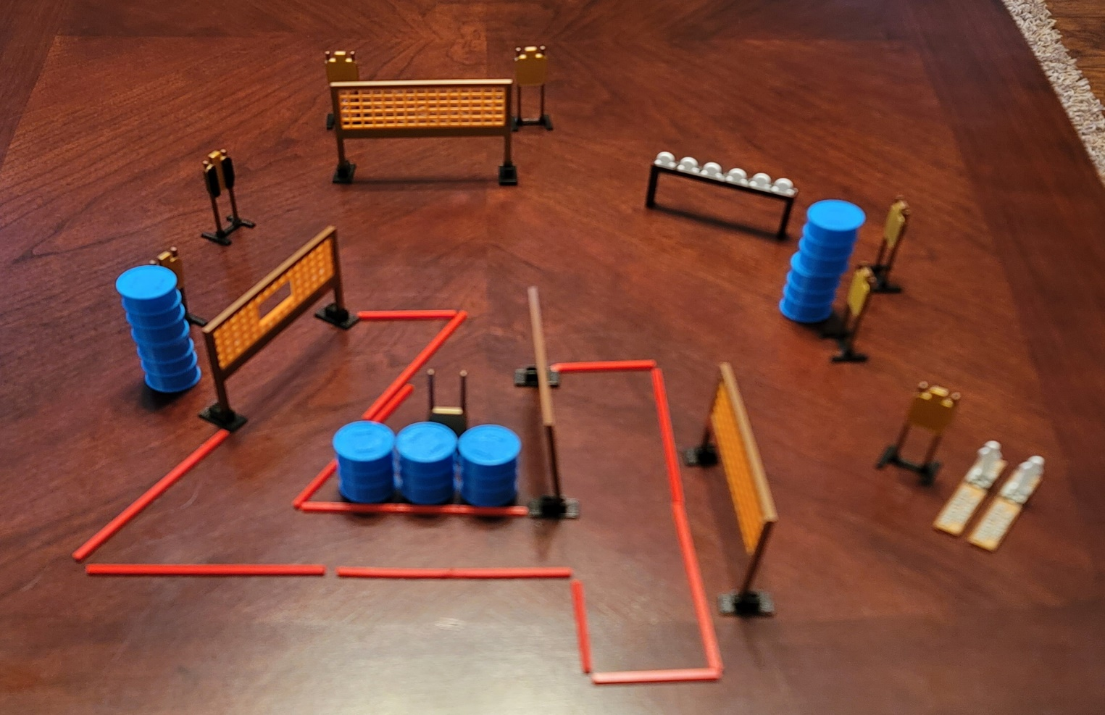
 | Dothan Gun Club – USPSA Match Too Close, Too Far Course Designer : Eric Henwood
Round Count 23 rounds 8 USPSA 5 falling plates, 2 colt poppers
Equipment List 8 wall feet 3 medium fault lines Plate rack (paint one as hard cover) 1 tux 7 targets

Slide 6
Too Close, Too Far
Written Stage Briefing
Too Close, Too Far is a 23 round, 115-point, Comstock course of fire. There are 8 USPSA targets and 7 steel. The best 2 hits on cardboard will score and steel must fall to score.
Handgun start position is anywhere completely outside the shooting area, wrists below belt. Handgun is loaded and holstered.
PCC start position is anywhere completely outside the shooting area, stock on belt. Loaded carbine is held with both hands.
On the audible start signal, engage targets as they become available from within the shooting area.

Slide 7
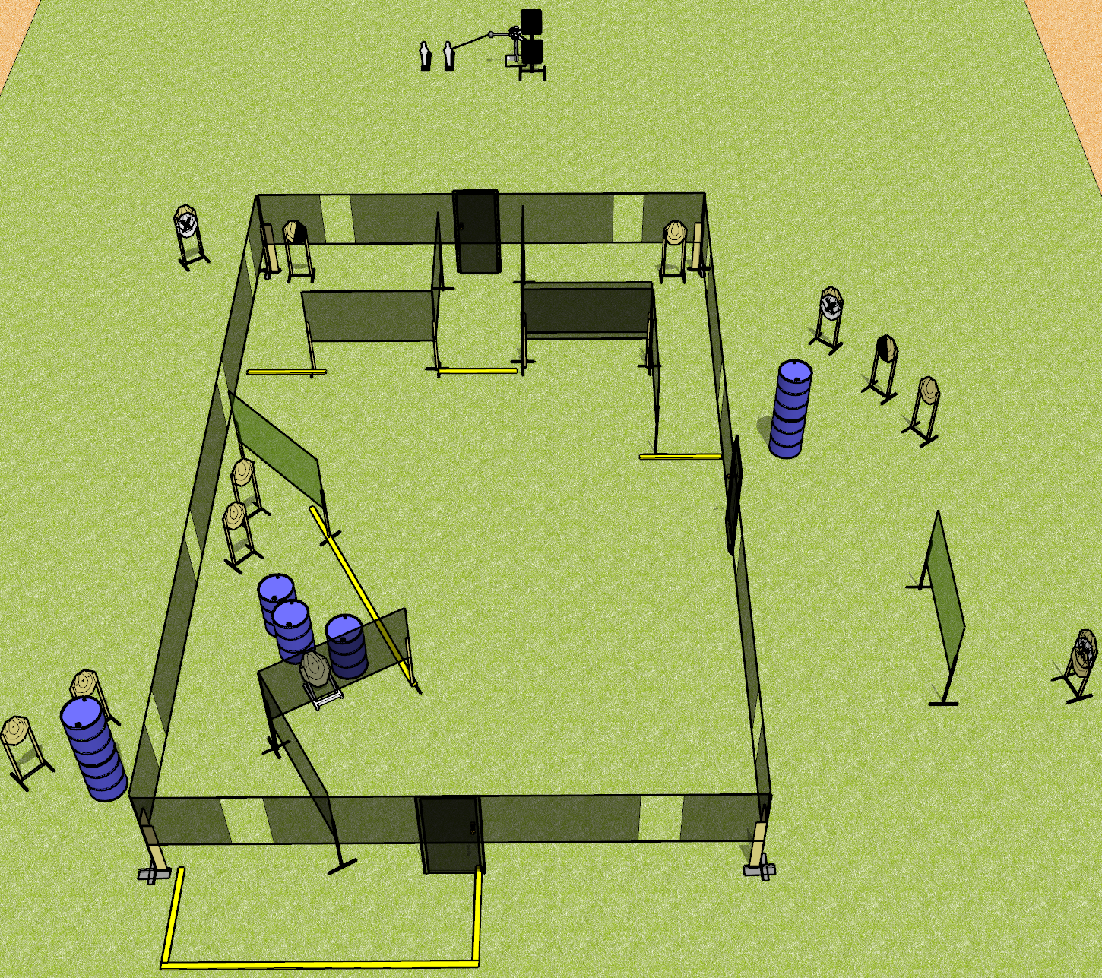
 | Dothan Gun Club – USPSA Match Leftovers Course Designer : Drew Coleman
Round Count 30 rounds 13 IPSC 2 mini 2 plates
Equipment List 4 wall feet 1 left + 1 right diag, 1 50% for low target 11 targets (9 + 2NS) Red stitch swinger + activator

Slide 8
Leftovers
Written Stage Briefing
Leftovers is a 30 round, 150-point, Comstock course of fire. There are 13 IPSC targets and 4 steel. The best 2 hits on cardboard will score and steel must fall to score.
The swinger is activated by poppers and remains visible at rest. Must be activated before being engaged.
Handgun start position is anywhere inside the shooting area, wrists below belt. Handgun is loaded and holstered.
PCC start position is anywhere inside the shooting area, stock on belt. Loaded carbine is held with both hands, safety on.
On the audible start signal, engage targets as they become available from within the shooting area.
Front and side doors (if present) must be shut prior to the start signal. Back door near the swinger will remain open.

Slide 9
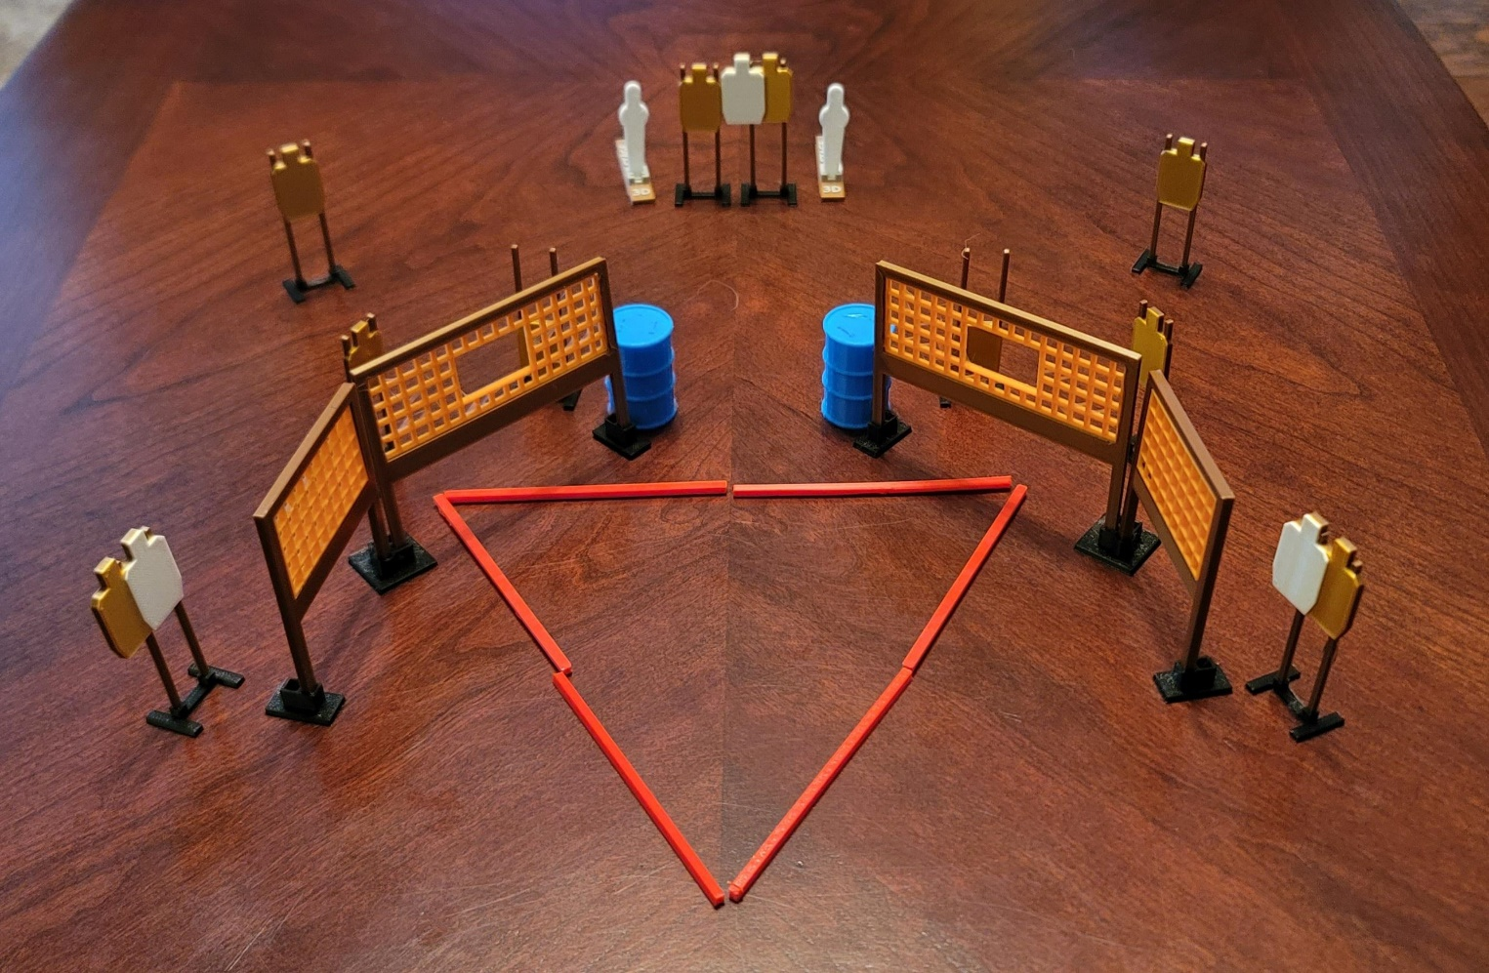
 | Dothan Gun Club – USPSA Match Bermuda Triangle Course Designer : Eric Henwood
Round Count 32 rounds 10 USPSA 2 mini poppers
Equipment List 8 wall feet 13 targets (10 + 3 NS)

Slide 10
Bermuda Triangle
Written Stage Briefing
Bermuda Triangle is a 32 round, 110-point, Comstock course of fire. There are 10 USPSA targets and 2 steel. The best 3 hits on cardboard will score and steel must fall to score.
Handgun start position is anywhere completely outside the shooting area, wrists below belt. Handgun is loaded and holstered.
PCC start position is anywhere completely outside the shooting area, stock on belt. Loaded carbine is held with both hands.
On the audible start signal, engage targets as they become available from within the shooting area.

